Slide 1
Homework Assignment #1 Matrix Multiplication in Multi-Process
Professor： Hsung-Pin Chang
TA ：Wei-Shou Chen

Slide 2
Outline
Background
Multi-process
Shared memory
Homework Assignment #1

Slide 3
Outline
Background
Multi-process
Shared memory
Homework Assignment #1

Slide 4
Multi-process
A process may create several new processes
The creating process is called parent
The new processes are called children of that process

Slide 5
Multi-process
Execution
Parent and children execute concurrently, or
Parent waits until children terminate
wait() system call in Linux
Address space
Child duplicate of parent (has the same program and data as the parent), or
fork() system call creates a new process in Linux
Child has a new program loaded into it
exec() system call replaces the process’ memory space with a new program in Linux

Slide 6
The fork() System Call
Memory
(Parent)
(Child)
Process A
Original image
Process B
New image
fork()
NCHU System & Network Lab

Slide 7
The exec() System Call
Memory
(Parent)
(Child)
Process A
Original image
Process B
Load another image
New image
fork()
exec()
NCHU System & Network Lab

Slide 8
UNIX Process Creation
See the following slide!
Each process has a unique process id (PID)
A new process is created by the fork() system call
The new (child) process duplicates the address space of the parent process
Child and parent continue execution at the instruction after the fork() system call
Child: return value of fork is 0
Parent: return value of fork is PID of the child process
The execlp() system call is used to load a new binary file into memory – destroying the old code

Slide 9
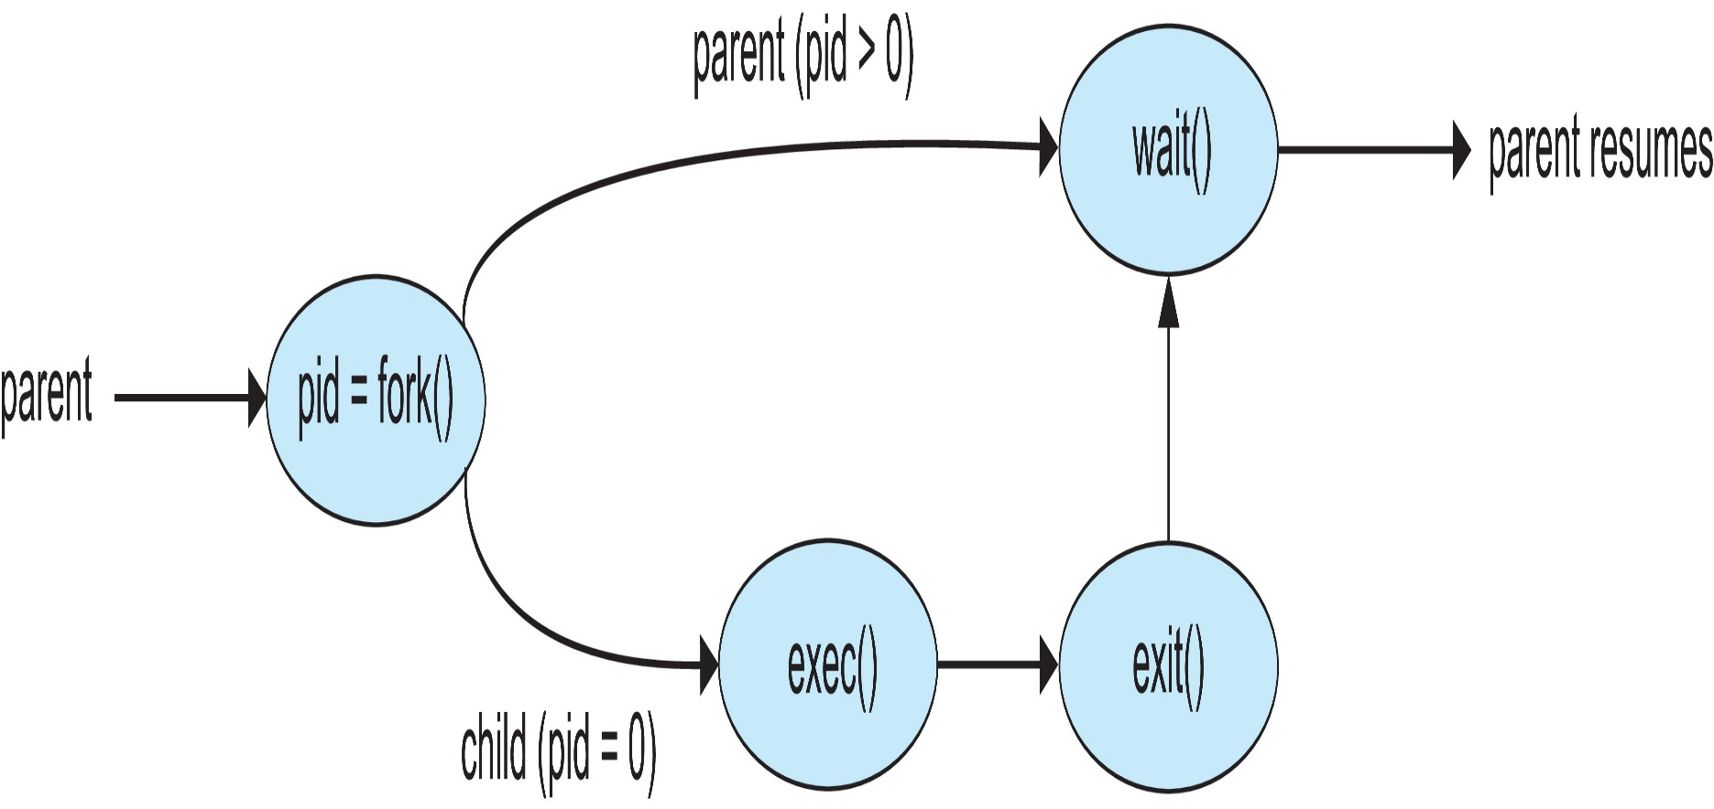
Process Creation

Slide 10
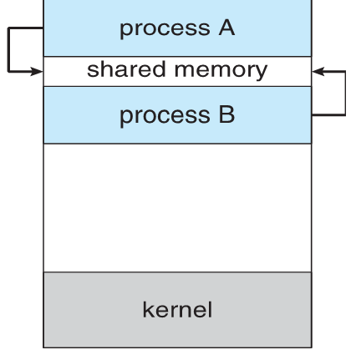
What is shared memory?

Slide 11
Shared memory
Communicating processes need to establish a region of shared memory
Reside in the address space of the process creating the shared-memory region
Other processes using this region must attach it to their address space
Shared memory remove the restriction that one process cannot access another process’s memory

Slide 12
POSIX API
Function | Description
shm_open() | Creates and opens a new shared memory object or opens an existing object.
ftruncate() | Set the size of a file to the value specified by length.
mmap() | Creates a new mapping in the calling process’s virtual address space.
munmap() | Removing a mapping from the calling process’s virtual address space.
shm_unlink() | Removes the shared memory object specified by name.

Slide 13
Creating Shared Memory Objects
shm_open()
#include<sys/mman.h>
int shm_open(const char *name, int oflag, mode_t mode);
EX: shm_open( NAME, O_RDWR, 0666 );
Returns file descriptor on success, or –1 on error
name : Identifies the shared memory object to be created or opened.
oflag : Mask of bits that modify the behavior of the call.
mode : File Permission

Slide 14
Bit values for the shm_open() oflag argument
Library fcntl.h
Flag | Description
O_CREAT O_EXCL | Create object if it doesn’t already exist With O_CREAT, create object exclusively
O_RDONLY O_RDWR | Open for read-only access Open for read-write access
O_TRUNC | Truncate object to zero length

Slide 15
Bit values for the shm_open() mode argument
Library sys/stat.h
Constants for File Permission Bits
Constant | Octal value | Permission bit
S_IRUSR S_IWUSR S_IXUSR | 0400 0200 0100 | User-read User-write User-execute
S_IRGRP S_IWGRP S_IXGRP | 040 020 010 | Group-read Group-write Group-execute
S_IROTH S_IWOTH S_IXOTH | 04 02 01 | Other-read Other-write Other-execute

Slide 16
Creating Shared Memory Objects (cont.)
ftruncate()
#include<unistd.h>
int ftruncate(int fildes, off_t length);
EX: ftruncate( fd, 2048);
Return 0 on success, or –1 on error
fildes : File descriptor.
length : Size of the file.

Slide 17
Creating Shared Memory Objects (cont.)
mmap()
#include<sys/mman.h>
void *mmap(void *addr, size_t length, int prot, int flags,
int fd, off_t offset);
EX: mmap(NULL, 1024, PROT_WRITE, MAP_SHARED
shm_fd, 0);
Returns starting address of mapping on success,
or MAP_FAILED on error

Slide 18
Creating Shared Memory Objects (cont.)
mmap() (cont.)
void *mmap(void *addr, size_t length, int prot, int flags,
int fd, off_t offset);
addr : Indicates the virtual address at which the mapping is to be located.
length : Specifies the size of the mapping in bytes.
prot : A bit mask specifying the protection to be placed on the mapping.
flags : A bit mask of options controlling various aspects of the mapping operation.
fd : A file descriptor identifying the file to be mapped.
offset : Specifies the starting point of the mapping in the file.
Notes:
Prot 是指map到的這段記憶體 所開出去的權限

Slide 19
Memory protection values prot argument
Value | Description
PROT_READ | The contents of the region can be read
PROT_WRITE | The contents of the region can be modified
PROT_EXEC | The contents of the region can be executed
PROT_NONE | The region can not be accessed

Slide 20
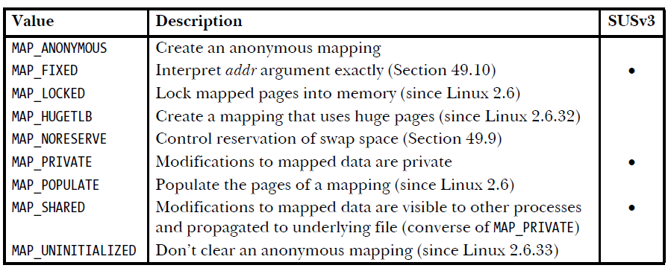
Bit-mask values for the mmap() flags argument

Slide 21
Removing Shared Memory Objects
munmap()
#include< sys/mman.h>
int munmap(void *addr, size_t length);
EX: munmap( address, 2048);
Return 0 on success, or –1 on error
addr : The starting address of the address range to be unmapped.
length : The size (in bytes) of the region to be unmapped.

Slide 22
Removing Shared Memory Objects
shm_unlink()
#include< sys/mman.h>
int shm_unlink(const char *name);
EX: shm_unlink( NAME );
Return 0 on success, or –1 on error
name : Specifies the name of the shared memory object to be unlinked.

Slide 23
Outline
Background
Multi-process
Shared memory
Homework Assignment #1

Slide 24
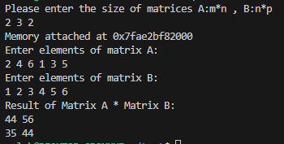
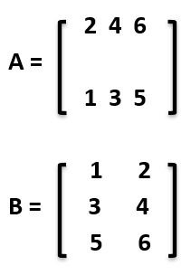
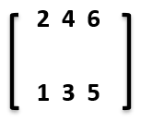
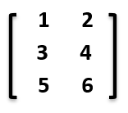
Homework Assignment #1
m=2, n=3, p=2
56
35 44
A x B =
=

Slide 25
Homework Assignment #1 (cont.)
Demands：
Each row of the matrix must calculate by one child process
The rows and columns of the matrix must be determined by the user input
Submission format ： hw1_<student number>.zip
Hw1.c
execution result
Score:
Matrix Multiplication & user input (60pt)
Multiprocess (40pt)

